Slide 1
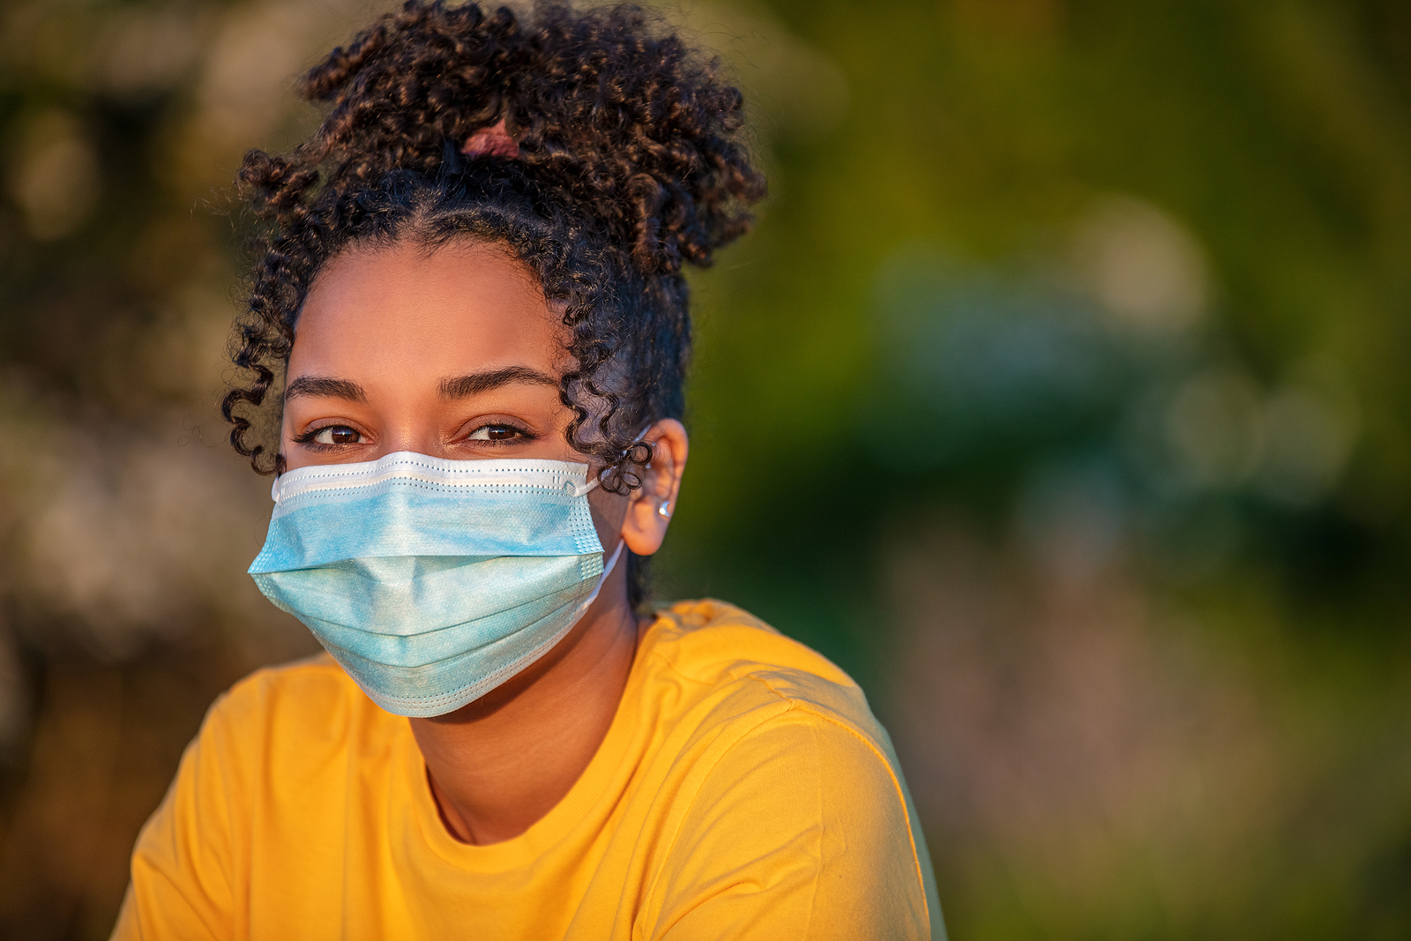
“Everyday is a challenge, but somehow someway I manage to make it through”
Add image that represents this persona
Goals
Graduate high school and attend a four year college
Get help for anxiety and depression
Frustrations
Not sure where to go to get mental health resources
Not sure what mental health resources are or what mental health looks like
Afraid to ask for help of fear of being stigmatized
Rachel
Age:
Education:
Hometown:
Family:
Occupation:
16-26
High School
Denver, Colorado
1 Brother, 2 Sisters
Student
Rachel is a 18 year old that just finished high school and will be soon going off to college. She has episodes of anxiety frequently because of bullying and trauma she has experienced as a teenager. This makes her daily life challenging as she tries to mask these things so people don’t notice.

Slide 2
USER STORY
As a student that struggles with mental health, I want to have access to resources so that I can get rid of my anxiety and depression.

Slide 3
Persona: Rachel
Goal: Find mental health resources
ACTION | Search for app in the app store | Use current location | User picks a resource
TASK LIST | Tasks A. User goes to the app store B. Downloads the app and opens it | Tasks A. User allows the app to use their current location or city and state to show locations of resources | Tasks A. User is presented with resources they can choose from B. User picks a location to go seek the help they need
FEELING ADJECTIVE | User emotions | Neutral | Happy, but curious
IMPROVEMENT OPPORTUNITIES | The app should have a unique title and logo so it is easy to find in the app store. | App should explain why it needs to use their current location | Show what locations offer what resources for each mental health need.

Slide 4
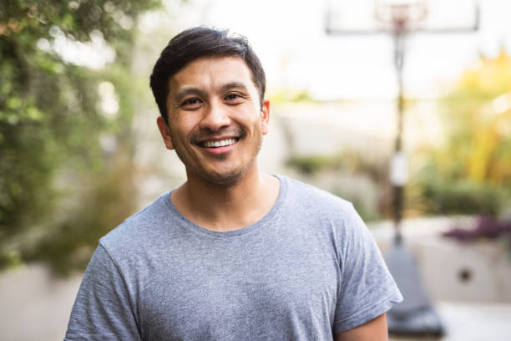
“My main goal is to provide for my family to make sure they have everything they need”
Add image that represents this persona
Goals
Obtain a promotion to become a journeyman welder
Get help with mental health
Start a family
Frustrations
Not sure where to go to get mental health resources
Not sure what mental health resources are or what mental health looks like
Afraid to ask for help of fear of being stigmatized
Name: Dominic
Age:
Education:
Hometown:
Family:
Occupation:
24-30
Community College
New Orleans, LA
1 Sister, 1 dog
Welder
Dominic is a 25 year old welder that recently moved back to New orleans. He has a lot on his plate as he is taking care of his immediate family while working full time. He wants to become a journeyman welder and work his way up in the ranks. With all of this going on, Dominic struggles with his mental health and has episodes of depression and anxiety from past traumas.

Slide 5
USER STORY
As a full time worker and care giver for my family,
I want to find a way to focus on my mental health
so that I can be happier and make my mental health better.

Slide 6
Persona: Dominic
Goal: Find mental health resources
ACTION | Use search engine to find website | Make a account | Answer questions from the app | App provides resources user can choose from
TASK LIST | Tasks A. Open a search engine and find the website B. Click on the website and open it | Tasks A. Make an account with basic contact info | Tasks A. The app will ask basic questions to see what resources the user needs B. User will answer these questions C. | Tasks A. User sees resources B. Chooses resource they need
FEELING ADJECTIVE | Neutral | Curious as to why he needs to make an account | Anxious | Happy
IMPROVEMENT OPPORTUNITIES | Have a simple URL and key words so that it is easy to find. | Make this feature optional |  | Offer locations as well

Slide 7
PROBLEM STATEMENTS
Problem Statement
Rachel is a full time student with anxiety and depression who needs mental health resources
because she wants to be able to be herself.
Dominic is a welder and caregiver who needs resources for his mental health because
he wants to combat his anxiety and depression.

